Slide 1
MPLS TE
Antonio Virdis
Assistant Professor@ University of Pisa
antonio.virdis@unipi.it
Notes:
http://www.ciscopress.com/articles/printerfriendly/426640

Slide 2

MPLS TE
Traditional IP networks uses destination-based routing
Explicit routing (e.g. source based routing) is not supported
MPLS networks can support destination-based and explicit routing simultaneously
TE is a generic name corresponding to the use of different technologies to optimize the utilization of a given backbone capacity and topology.
MPLS TE uses extensions to RSVP and MPLS forwarding to support constrained-based routing (taking into account more information on network constraints and policy requirements)
Notes:
TE is a generic name corresponding to the use of different technologies to optimize the utilization of a given backbone capacity and topology.

Slide 3
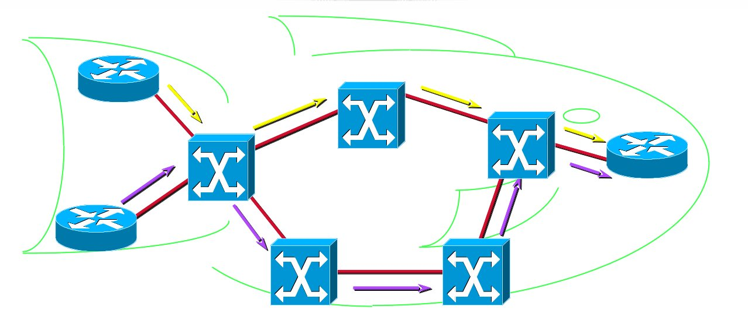

MPLS TE
Resource optimization, avoid over- and under- utilization of network parts, traffic not being aggregated on the shortest path

Slide 4
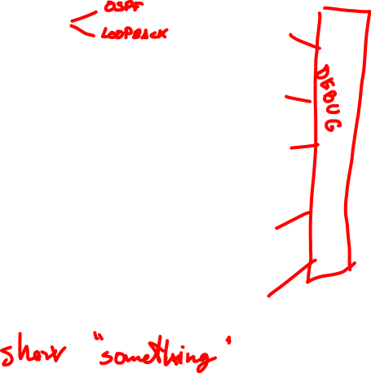
Configuration Steps
prerequisites
CEF and tagswitch on every interface
Enable tunnel creation
Enable TE in IGP
Create tunnel(s)

Slide 5
OSPF configuration
RIP is a distance vector routing protocol, only link-state routing protocols that provide constant updates on the link state can be used
For this reason we need to configure OSPF (already done in the MPLS scenario)
router ospf 100
network 10.1.1.0 0.0.0.3 area 1
network 10.2.2.0 0.0.0.3 area 1
network 192.168.1.0 0.0.0.255 area 1
network 192.168.2.0 0.0.0.255 area 1
network 192.168.3.0 0.0.0.255 area 1
as seen from R1

Slide 6
Loopback configuration
It is mandatory to setup a Loopback interface with IP mask of 32 bits on each router to be used as router-id
interface Loopback0
ip address 172.16.1.1 255.255.255.255
router ospf 100
network 172.16.1.1 0.0.0.0 area 1
Notes:
Configure a loopback interface for tunnel association to the TE tunnel

Slide 7
MPLS
Cisco MPLS implementation requires CEF – Cisco Express Forwarding
CEF is an advanced layer 3 switching technology adopted in cisco routers to increase packet switching speed
CEF keeps track of adjacencies to build the Forwarding Information Base (FIB)

Slide 8
MPLS Configuration
Configugre
ip cef
Enable CEF
interface Serial 2/0
mpls ip
Enable tag switching on this interface
Check
show mpls interfaces detail
Notes:
Additional ref:
https://www.cisco.com/c/en/us/support/docs/multiprotocol-label-switching-mpls/mpls/13731-mpls-te-ospf.html

Slide 9
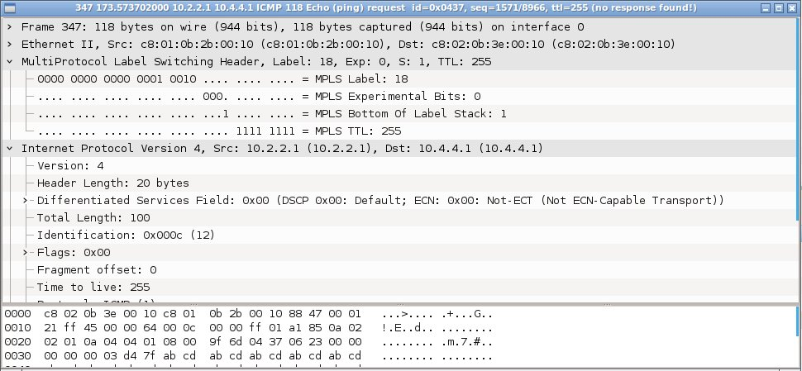
Test
Open Wireshark and try to ping VoipServer from VoipClient
Notes:
if you look at the connection R1-R2, you should see MPLS header only for ping requests (client->server), and not for ping responses. This is due to the Penultimate Hop Popping.

Slide 10


Slide 11
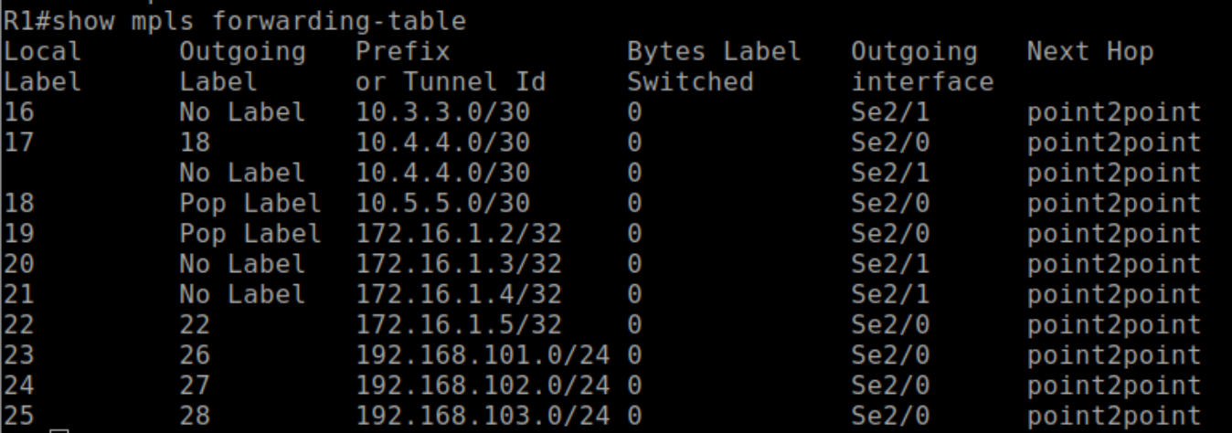
Test
show mpls forwarding table

Slide 12
MPLS - TE
Unlike conventional IP routing MPLS traffic engineering (TE) uses the implicit MPLS characteristic of separation between the forwarding plane and the control plane to allow routing decisions to be made on criteria other than the destination address
Label switched paths (LSPs), referred as “traffic engineering tunnels” are setup to steer traffic through the network allowing links not included in the shortest path to be used

Slide 13

MPLS TE - enable Tunnels
Enable the creation of mpls tunnels for TE:
mpls traffic-eng tunnels
Enable tunnels creation on the router
Interface serial 2/0
mpls traffic-eng tunnels
ip rsvp bandwidth 512 512
Enable MPLS tunnel creation on the interface specifying the reservable bandwidth and the largest reservable flow on the interface
Enable TE extension on OSPF
router ospf 100
mpls traffic-eng area 1
mpls traffic-eng router-id Loopback0
RSVP adopted also as admission control
Notes:
why two “mpls traffic-eng tunnels” commands? The first one enables tunneling at the router level (global), the second one does it at the itnerface level.

Slide 14
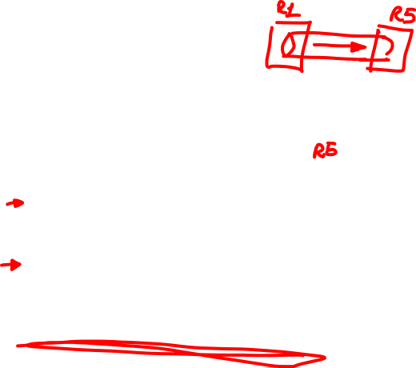
MPLS TE - Tunnels
Define a new (headend) tunnel:
interface Tunnel0
ip unnumbered Loopback0
tunnel destination 172.16.1.5
tunnel mode mpls traffic-eng
tunnel mpls traffic-eng autoroute announce
tunnel mpls traffic-eng priority 2 2
tunnel mpls traffic-eng bandwidth 400
tunnel mpls traffic-eng path-option 1 dynamic
The path of the tunnel will be dynamically selected
Check the status:
show mpls traffic-eng tunnels
Reservation priority for the tunnel
Notes:
By default, the tunnel interface is not announced into the IGP for use in the routing table. This will have to be configured explicitly for the tunnel interface to be used as the next hop in the routing table by the IGP.
This configuration has to be performed at the ingress of the tunnel (R1)
To check reachability show mpls traffic-eng topology path destination xxx.xxx.xxx.xxx

Slide 15

Having “fun” with show commands
show mpls interface detail
﻿show mpls traffic-eng tunnels
﻿show mpls traffic-eng topology
show mpls traffic-eng topology path destination xxx.xxx.x.x
﻿show mpls traffic-eng link-management igp-neighbors
﻿show mpls traffic-eng link-management interfaces
﻿show mpls traffic-eng link-management statistics
show ip route
Notes:
Configure R1 and R2. Partially configure R5 “forgetting” to include -mpls traffic-eng tunnels- in the interface configuration.
Then search the “bug” through show commands:
show mpls traffic-eng tunnels on R1: the tunnel is not working
show mpls traffic-eng topology path destination xxx.xxx.x.x: from R1 to R2 and vice-versa will work. Towards R5 will fail instead
show mpls interface detail on R5: notice tunneling is disabled.
Fix it
show mpls traffic-eng topology on R1: show the correct resource allocation on R1 and R2

Slide 16

interface serial 2/1
shutdown
Notes:
We already have a tunnel between R1 and R5, allocating 400 Kbps
We now shutdown interface s2/0 of R1 (to avoid using the lower part of the network).
We then try to install a new tunnel between R1 and R5, requesting 400 kbps, and having priority 3 3

Slide 17
MPLS TE – Dynamic Tunnels
Define a tunnel (headend) with dynamic path:
interface Tunnel01
ip unnumbered Loopback1
tunnel destination 172.16.1.5
tunnel mode mpls traffic-eng
tunnel mpls traffic-eng autoroute announce
tunnel mpls traffic-eng priority 5 5
tunnel mpls traffic-eng bandwidth 400
tunnel mpls traffic-eng path-option 1 dynamic
setup & hold
priorities
Check tunnel status
﻿show mpls traffic-eng tunnels brief
Notes:
This configuration has to be performed at the ingress of the tunnel (R1)
A tunnel interface can have several path options, to be tried successively

Slide 18

MPLS TE – Dynamic Tunnels (2)
Setup
Hold
Tunnel0
Setup
Hold
Tunnel1

Slide 19
Differentiate routing
192.168.101.0
Tunnel0
Tunnel1
192.168.102.0
To differentiate routing you can set static routes (e.g. for load balancing):
ip route 192.168.101.0 255.255.255.0 Tunnel0
ip route 192.168.102.0 255.255.255.0 Tunnel01
Notes:
This configuration has to be performed at the ingress of the tunnel (R1)

Slide 20
Test 1
Generate tunnel0 (priority 2 2)
Generate tunnel01 (priority 3 3)
Turn on serial 2/1 on R1
Increase priority of tunnel01 to 1 1
Check tunnel status at each step
Observe traffic

Slide 21


MPLS TE – Explicit-path Tunnels
Define a tunnel (headend) with explicit path:
interface Tunnel1
ip unnumbered Loopback0
tunnel destination 172.16.1.5
tunnel mode mpls traffic-eng
tunnel mpls traffic-eng autoroute announce
tunnel mpls traffic-eng priority 2 2
tunnel mpls traffic-eng bandwidth 400
tunnel mpls traffic-eng path-option 1 explicit name longpath
tunnel mpls traffic-eng path-option 2 dynamic bandwidth 400
tunnel mpls traffic-eng path-option 3 dynamic bandwidth 0
Define the path:
ip explicit-path name longpath enable
next-address 10.2.2.2
next-address 10.3.3.2
next-address 10.4.4.2
Notes:
This configuration has to be performed at the ingress of the tunnel (R1)
A tunnel interface can have several path options, to be tried successively

Slide 22

tunnel mpls traffic-eng path-option 1 explicit name longpath
tunnel mpls traffic-eng path-option 2 dynamic bandwidth 400
tunnel mpls traffic-eng path-option 3 dynamic bandwidth 0

Slide 23
Test 2
Remove either tunnel0 or tunnel01
Create tunnel1
Check where traffic is going

Slide 24
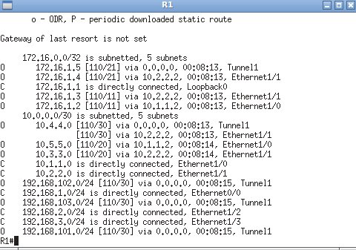
Test 2
show ip route

Slide 25
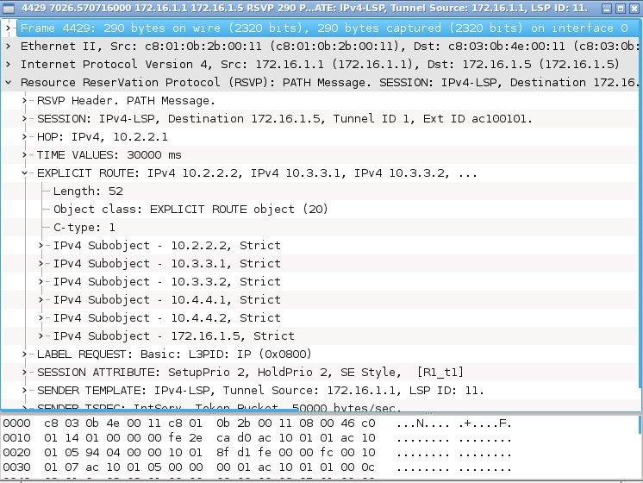
Test 2
RSVP messages can be seen

Slide 26
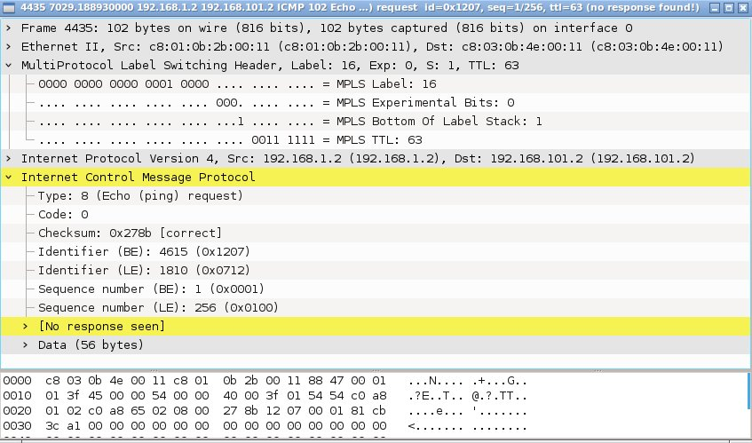
Test 2
Open Wireshark on one of the links in the long path and try to ping a Server from a Client
Response is sent on the short path!

Slide 27
Path protection
Notes:
https://www.cisco.com/c/en/us/td/docs/ios-xml/ios/mp_te_path_protect/configuration/xe-3s/mp-te-path-protect-xe-3s-book/mp-te-path-prot.html#:~:text=Glossary%20Close-,MPLS%20Traffic%20Engineering%20(TE)%20Path%20Protection,traffic%20engineering%20(TE)%20tunnels.

Slide 28
Path protection (2)
interface tunnel2
…
tunnel mpls traffic-eng path-option 1 explicit name shortpath
tunnel mpls traffic-eng path-option protect 10 explicit name longpath
ip explicit-path name shortpath enable
next-address 10.1.1.2
next-address 10.5.5.2

Slide 29
Test 3
Create a tunnel between R1 and R5
Use an explicit path R1-R2-R5 as primary
Use an explicit path R1-R3-R4-R5 as secondary
Observe traffic
Shutdown any interface of R2
Observe traffic again

